Slide 1
Checksum 101
Ross Spencer
Andrea Byrne
Jan Hutař
13/01/2016

Slide 2
Mysteries of Checksums -- two truths and a lie (JH)
A checksum can be reverse engineered -- you can chuck a checksum in a program and derive the content the checksum was created from.
A checksum can be created from a lot of things, from computer programs to word documents to sentences typed into a command line
MD5, one of the checksum algorithms that Rosetta uses, stands for message-digest 5 and replaced MD4 in the early 90s.

Slide 3
Checksums – why? (RS)
why do we use checksums; policy – Integrity:
“This policy deals with the integrity of digital content. Digital content is information encapsulated in one or more digital objects. Within this context, integrity of a digital object is the quality of its content remaining ‘uncorrupted and free of unauthorized and undocumented changes’” (UNESCO 2003).
Moving files – validation after the move
Working with files – uniquely identifying what we’re working with
Security… a by-product of integrity

Slide 4
What do checksums look like (RS)
Hexadecimal notation, making a bigger number look smaller!
Numbers 0-9
And Letters A-F
---
281,949,770,000,000,000,000,000,000,000,000,000,000
becomes:
d41d8cd98f00b204e9800998ecf8427e

Slide 5
What do checksums look like (RS)
Sonya Behrnes
d0e29653ddca52e9c9dd4525731fef5e
MD5
Zhimin Ding
bcdebe79c66b24c3f9cc5b61f6a6ee8425ce87b8
SHA1
Sarah Cho
c9c44567cc434134b33f6178fa70591f3d0a9a979bb012de8512648e4eccab95
SHA256
MD5, SHA1, SHA256 are using different algorithms

Slide 6

What do checksums look like (RS)
USA: f75d91cdd36b85cc4a8dfeca4f24fa14
USB: 7aca5ec618f7317328dcd7014cf9bdcf

Slide 7
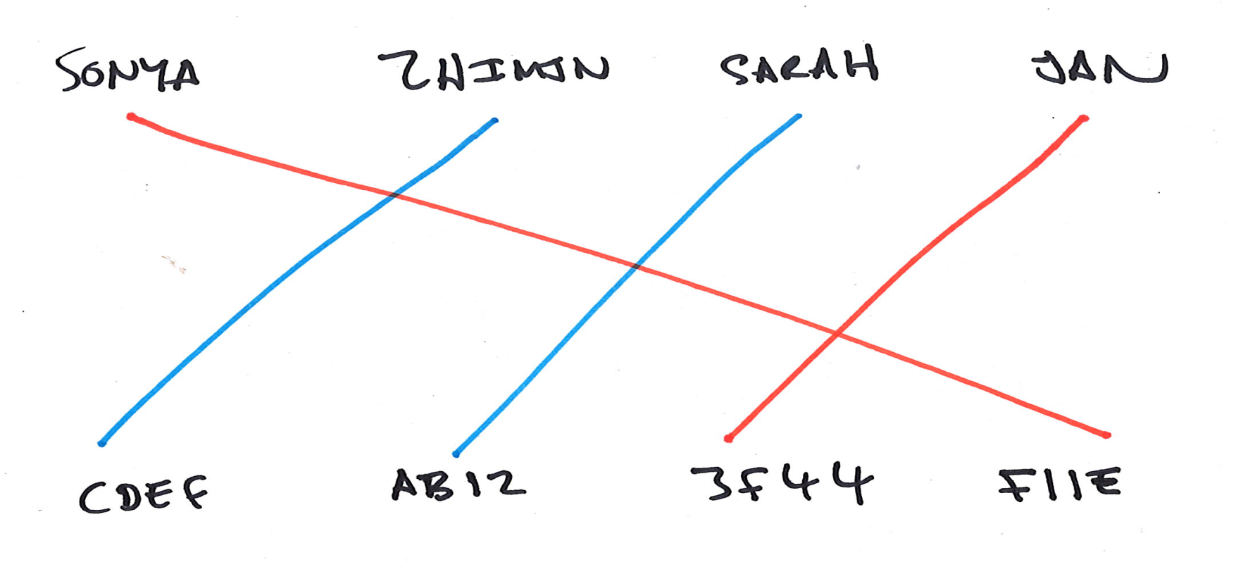
What are checksums doing? (RS)
Deterministic – The same input gives the same output
Uniform/Even distribution – input shared equally across output

Slide 8
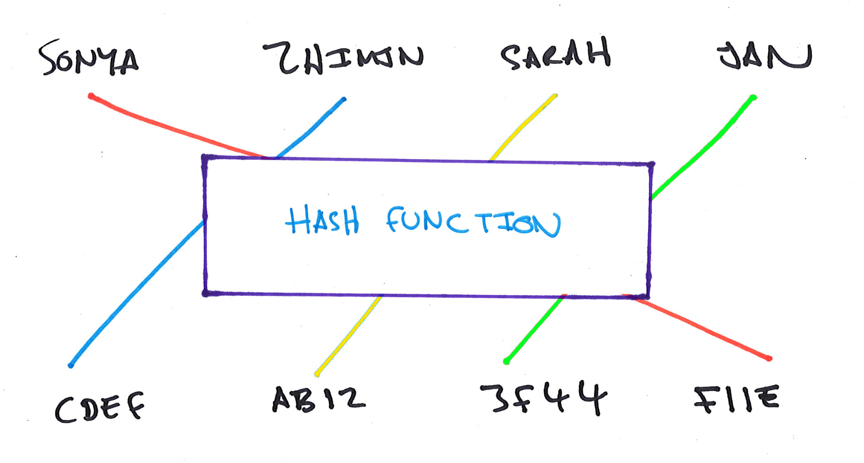
An algorithm does the computing bit… (RS)

Slide 9
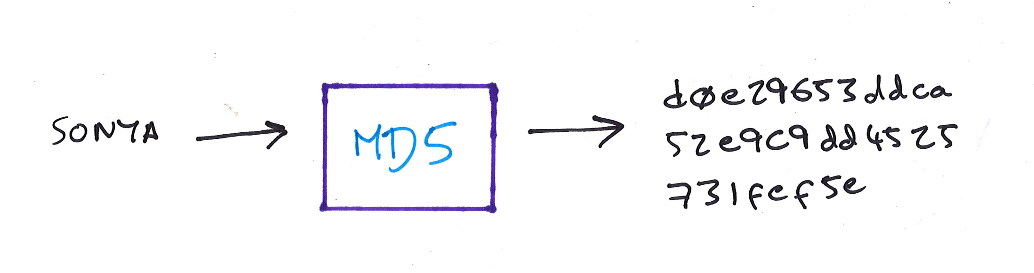
MD5 or… (RS)
The algorithm computing the checksum varies in complexity and goes by different names… e.g. MD5:
A checksum algorithm is a one way function…
“d0e29653ddca52e9c9dd4525731fef5e” cannot be turned back into “Sonya!”

Slide 10

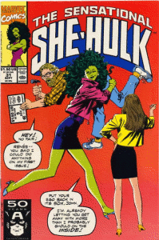


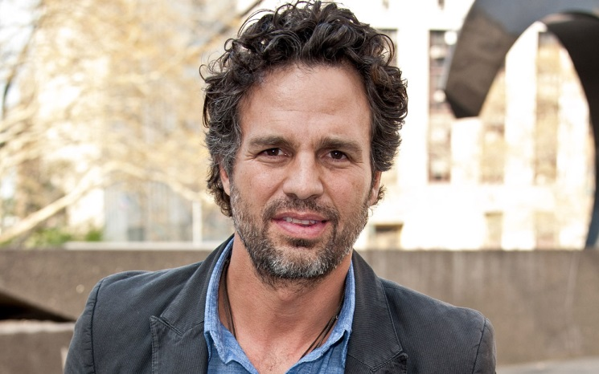
It’s irreversible:
Think: Susan Storm, She Hulk, and The Thing
Rather than: The Hulk

Slide 11
Why do we always talk about the same ones? (RS)
Namely: CRC32, MD5, SHA1, SHA256…
different algorithms
DROID can only handle MD5 and a checksum called SHA256
MD5 is the only overlap with Rosetta (at present)
Rosetta handles (creates and validates):
CRC32
MD5
SHA1

Slide 12
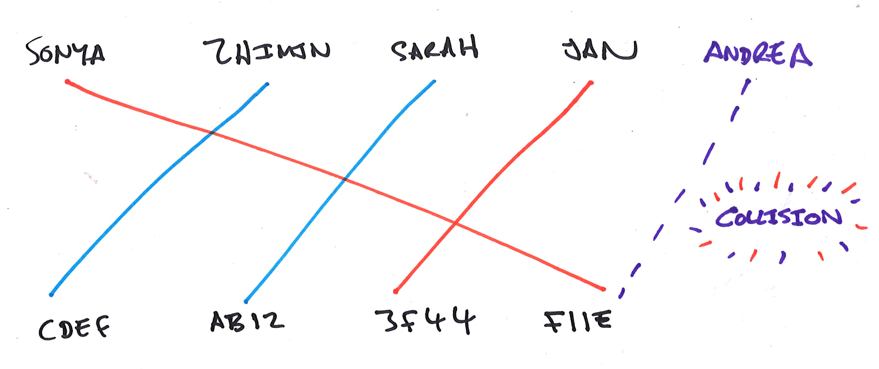
Why multiple checksums? (RS)
There are a limited number of unique numbers that can be output by a checksum algorithm, so sometimes we see collisions:
4 possible outputs, 5 inputs:

Slide 13
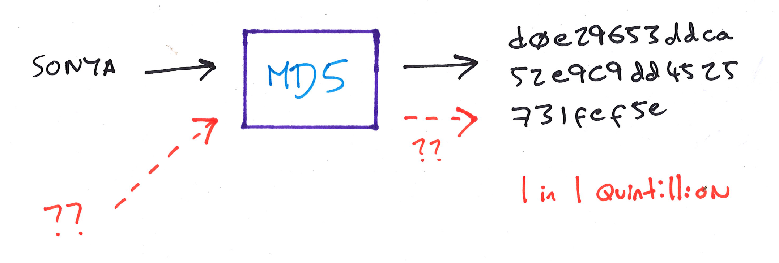
Collisions, really? (RS)
But also keep in mind the probability of that happening for more complex algorithms:

Slide 14
The probabilities are low (files needed for 1 collision, 50% chance) (RS)
CRC32 - 32-bit output - 8 character length
77 Thousand, 165 – 77165
MD5 - 128-bit output - 32 character length
21 Quintillion - 21,719,643,148,400,763,000
SHA1 - 160-bit output - 40 character length
1 Septillion - 1,423,418,533,373,592,400,000,000
SHA256 - 256-bit output - 64 character length
400 Undecillion - 400,656,698,530,848,040,000,000,000,000,000,000,000
4.5 million (4,443,745) files in Rosetta (as of 13/01/2016)

Slide 15
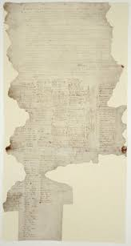
What if we got one? (RS)
Archivists have the concept of fixity – indicators of the file not changing, but also – we can understand what the file is…
Two files the same according to checksum:
What was the last accessed date?
What is the file name?
What is the file size?
What is the file type?
What does it look like?
We can figure it out!

Slide 16
So why? (RS)
We will ensure uniqueness
We can automate processes with the files better with checksums (they’re just numbers!)
Some may have a preference – it is convenient for us that Rosetta handles MD5 as well!
Future proof – one day we will have a lot more files!
Security – for most altruistic purposes, our checksums are okay… but older checksums can be hacked (engineered) – we keep this in mind 10% of the time we talk about them in an archive…

Slide 17
Checksums – where do they come from? (RS)
We generate them with a tool:
Free Commander (Windows)
online tool on the Internet (http://www.md5.cz/)
SHA1SUM. MD5SUM, (Linux)
DROID!!
We create a list and compare and validate with another:
Spreadsheet
SHA1SUM, MD5SUM (Linux)
AVPreserve Fixity: https://vimeo.com/100311241
My comparator: https://github.com/exponential-decay/checksum-comparator
Other tools out there, many internet links!

Slide 18
Tools using checksums (RS)
Internet behind-the-scenes, verify data being sent
Rsync – improve efficiency of backups/data moves
Digital Asset Management systems – file management – ensure storage integrity/accurate download and access
DP systems – preserving files (integrity, authenticity)
Law Enforcement – Software comparison databases – National Software Reference Library
HW – storage layers have their own checksums check/validation
Other cool uses:
Information management systems – de-duplication tools - removing duplicate files with good reliability – files with different names but same content produce the same checksum!

Slide 19
True or False What changes a checksum (AKB)
Changing a name?
Changing one byte?
Changing an extension?
Changing file format (ie. format migration)?

Slide 20
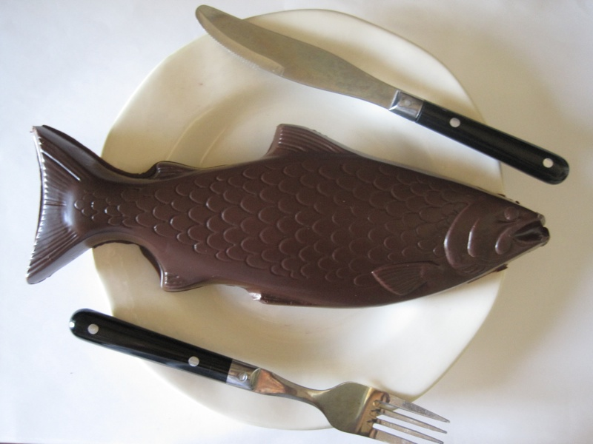
Hands on exercise (JH)
find and run the tool (FreeCommander by TSS) on your computer
create checksum for 3 files in your folder (j:\Exercise_checksums\your_name\create_checksums)
individual – 1 checksum file per file
move the checksums to the [validate_checksums] folder
validate checksum
identify problematic file (files)
repeat with shared checksum file
send me results by email
http://www.chocablog.com/wp-content/uploads/2011/11/chocolate-fish.jpg

Slide 21
More (advanced) reading…
http://preshing.com/20110504/hash-collision-probabilities/
http://everydayinternetstuff.com/2015/04/hash-collision-probability-calculator/
http://www.unixwiz.net/techtips/iguide-crypto-hashes.html

Slide 22
“I was having nightmares about the integrity of my data and thought I was losing sleep… I looked at my checksums and found that I hadn’t lost any…” - @beet_keeper

Slide 23
498cd895eb5a102c5aeb977e2b928dee
Thank you!

